Slide 1
How to Renew Construction Stormwater NOIs in GEOS
Presented by:
Heather Kelley, Program Manager
Tabitha Shiflett, Business Support Analyst
Lauren McDaniel & Maddy Entrekin, Environmental Specialists
Cartersville - Mountain District Office,
Georgia EPD

Slide 2
RENEWAL PROCESS – GEOS
GEOS – Georgia EPD Online (Permitting) System
How to get there:
https://geos.epd.georgia.gov/GA/GEOS/Public/GovEnt/Shared/Pages/Main/Login.aspx
When:
Existing Construction Stormwater NOIs should be renewed starting August 1st, 2023 and within 90 days after August 1st, 2023 (Primary and Tertiary NOIs only)
Online Instructions “Entering a Reissuance…”
https://epd.georgia.gov/construction-stormwater-instructions
NOTE: Changes cannot be made to the NOI until the Renewal NOI application is submitted and approved; once the Renewal NOI has been approved, submit a Modification NOI application to make any changes

Slide 3
Renewal process – geos – continued
Log into your GEOS user account (For Primary and Tertiary NOIs)
From My Dashboard/Homescreen OR from Manage Permits tab:
Find NOI that needs to be renewed and click on the blue “Action” button
Select “Renewal” from options and click “Ok”
Page 1 is the NOI type and cannot be changed, just click the blue “Next” button to continue
Page 2 is the NOI info page; review it and click the blue “Next” button

Slide 4
Renewal process – geos – continued
Page 3 is the attachment page and required documents should already be attached to the NOI, so click the blue “Next” button to continue
Page 4 is the validation page and there should be green checks in the middle of the screen, so click the blue “Next” button to continue
Page 5 is the submission page, so check the certification box near the top, enter the security question answer and PIN, then click the “Submit” button
NOTE: If the Renewal NOI application is successfully submitted to Georgia EPD, a “Submittal Receipt” message will appear

Slide 5
Important points
RO submission (to EPD) vs. Preparer submission (goes to RO only, for review and official submission to EPD)
1-day waiting period before Renewal NOI app should automatically approve once RO submits complete application
Edit Pending Submittals (unfinish apps and where ROs will find apps from Preparers that need to be submitted)
Track Submittals (all submitted apps located here)
Manage Permits (approved versions of apps)
NOTE: Changes cannot be made to the NOI until the Renewal NOI application is submitted and approved; once the Renewal NOI has been approved, submit a Modification NOI application to make any changes

Slide 6
common renewal NOI app issues – GEOS
Cannot locate pending Renewal NOI app from Preparer
Go to Edit Pending Submittals tab and review/submit the Renewal NOI app to Georgia EPD
ROs, owners, or operators have changed
There is a specific process to change the RO within an organization and a separate process to transfer NOIs due to a owner/operator change in GEOS
Contact Tabitha Shiflett at Tabitha.Shiflett@dnr.ga.gov regarding these types of changes
Changes regarding any other info on the NOI
Changes cannot be made to the NOI during the renewal process; once the Renewal NOI app has been approved, submit a Modification NOI app to update or correct the NOI

Slide 7
renewal issues – GEOS – Continued
Incorrect Permit Type
NOI Permittee Types cannot be changed during the renewal period, so contact Tabitha Shiflett at Tabitha.Shiflett@dnr.ga.gov at Georgia EPD for assistance
GEOS is requesting required documents again
Click the “Other” option and enter “Attached already” in description box that appears just below the required document
Red Xs on Validation Page
Click the “Previous” button and check that all required fields have been filled out and click the blue “Next” button again
GEOS is requesting payment again
Any unpaid fees or partial fees should be paid ASAP (3 payment options)
If a fee was previously waived by EPD, contact Tabitha Shiflett at Tabitha.Shiflett@dnr.ga.gov for assistance

Slide 8
renewal issues – GEOS – Continued
Incorrect security question answers and PIN on Submission Page
Save the pending Renewal NOI app and reset one or both as needed
PIN reset button is on Submission Page to the right of the PIN box; it’s the blue hyperlink labeled “Forgot Your PIN Number” and after you click it to reset the PIN, log out and back into your GEOS account to update it
Security question answers can be reset from the My Account tab near the top/left of the GEOS screen, then click on Security Questions tab (3rd one down on the left side)
Go to Edit Pending Submittals tab to find and submit the Renewal NOI app

Slide 9
Major Changes to the General Permit
Only Primary and Tertiary NOIs will be able to renew in GEOS
Secondary NOIs will no longer be available in GEOS as Secondary Permittees will no longer be required to submit a NOI; however, all Secondary Permittees are required to adhere to applicable permit parts and requirements of the Permit; Secondary Permittees should now sign the Primary Permittee’s erosion plan or addendum form
NOTE: The only change for Secondary Permittees is instead of submitting a NOI now, these permittees sign the Primary Permittee’s erosion plan or the addendum form attached to the Primary Permittee’s plan and sign again when final stabilization has been reached

Slide 10
Changes to the General Permit - continued
NOT applications should be submitted within 14 days of project completion (final stabilization)
Solar Farms may only submit Stand Alone NOIs
Buried Fiber Optics Utility Lines added as an exemption
Language clarifications

Slide 11
Additional Functions
Public Inquiry Portal – search for NOIs/NOTs
https://geos.epd.georgia.gov/GA/GEOS/Public/Client/GA_GEOS/Public/Pages/PublicApplicationList.aspx
Partial vs. Complete Submittal
Sampling Reports (separate app via GEOS)
Self reporting to be emailed directly to appropriate District Office (these can still be mailed/delivered to appropriate DO as well)
Self Reporting form template link
https://epd.georgia.gov/forms-permits/watershed-protection-branch-forms-permits/erosion-and-sedimentation-forms (at bottom of webpage)

Slide 12
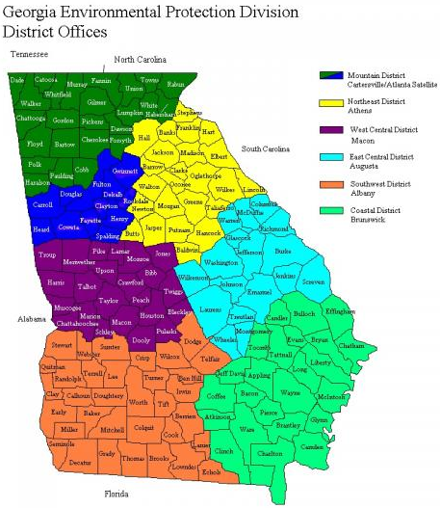
Resources
District Offices
7 office locations
Mountain District
Cartersville
770-387-4900
Atlanta
404-362-2671

Slide 13
Questions?

Slide 14

Contact Information
Heather Kelley
Program Manager
Ga DNR EPD, Mountain District Cartersville
16 Center Rd. Cartersville, GA 30121
Email: heather.kelley@dnr.ga.gov
Office Phone: 770-387-4900
Tabitha Shiflett
Business Support Analyst
Ga DNR EPD, Mountain District Cartersville
16 Center Rd. Cartersville, GA 30121
Email: tabitha.shiflett@dnr.ga.gov
Work Cell: 470-432-2076

